Slide 1
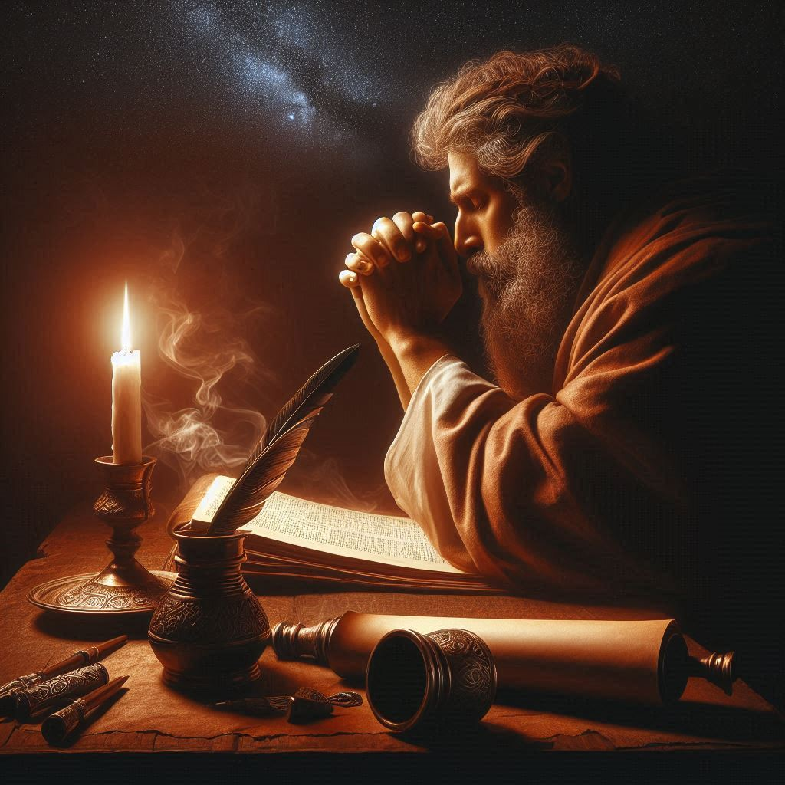
In The Day of My Trouble
Psalm 77
A Psalm of Asaph
Notes:
All of us experience trouble. Job said, “Man who is born of woman Is of few days and full of trouble.” In Psalm 77, the inspired psalmist Asaph shows us a process of emotions, words, and actions that helped him make it through the day of his trouble.

Slide 2
The Faithful Experience Days of Trouble
Job (Job 14:1; 7:6-7)
Moses (Deut. 1:9, 12).
Elijah (1 Kings 9:4).
David (Psalm 32).
Jeremiah (Jer. 20:15-18).
Asaph (Psalm 77)

Slide 3
In the Day of My Trouble
“I Cried out to God” (77:1-3).
Comparing present troubles to happier times (77:4-6).
Expressing troubling doubts (77:7-9).

Slide 4
In the Day of My Trouble
I will remember!
I will remember the works of the Lord (77:10-12).
I will remember God’s holiness, greatness, and power (77:13-14; Isa. 55:9; 1 Corinthians 10:13).
I will remember the Redeemer (77:15-19; 1 Peter 1:18-19).
I will remember my Shepherd (77:20; Ps. 23).

Slide 5
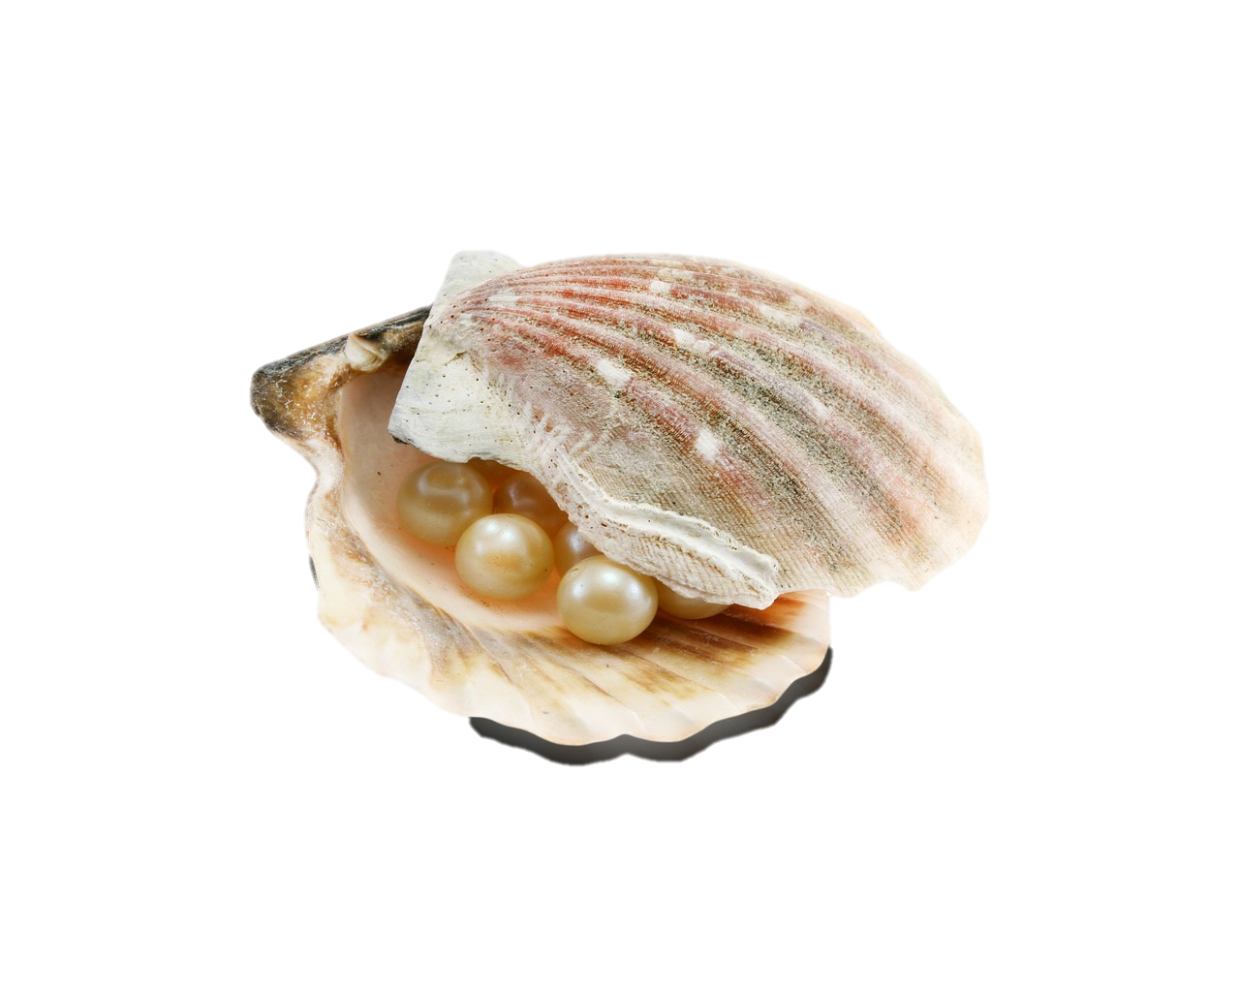
Pearls come from Pain
“The twelve gates were twelve pearls: each individual gate was of one pearl…” (Revelation 21:21)

